Slide 1



Cadbury Egypt – Pricing Optimization & Strategic Portfolio Actions
Author: Aya Tarek

Slide 2

CONTENTS
1. Executive Summary
2. Market Overview (Chocolate Tablets 100g)
3. KPI Dashboard & Business Relationships
4. Price vs Volume Relationship
5. Cost & Pricing Process Relationship
6. Strategic Challenges
7. Strategic Recommendations
8. Data Experimentation Plan
9. Business Impact & Next Steps
10. Summary Message to Leadership

Slide 3


01
Executive Summary

Slide 4
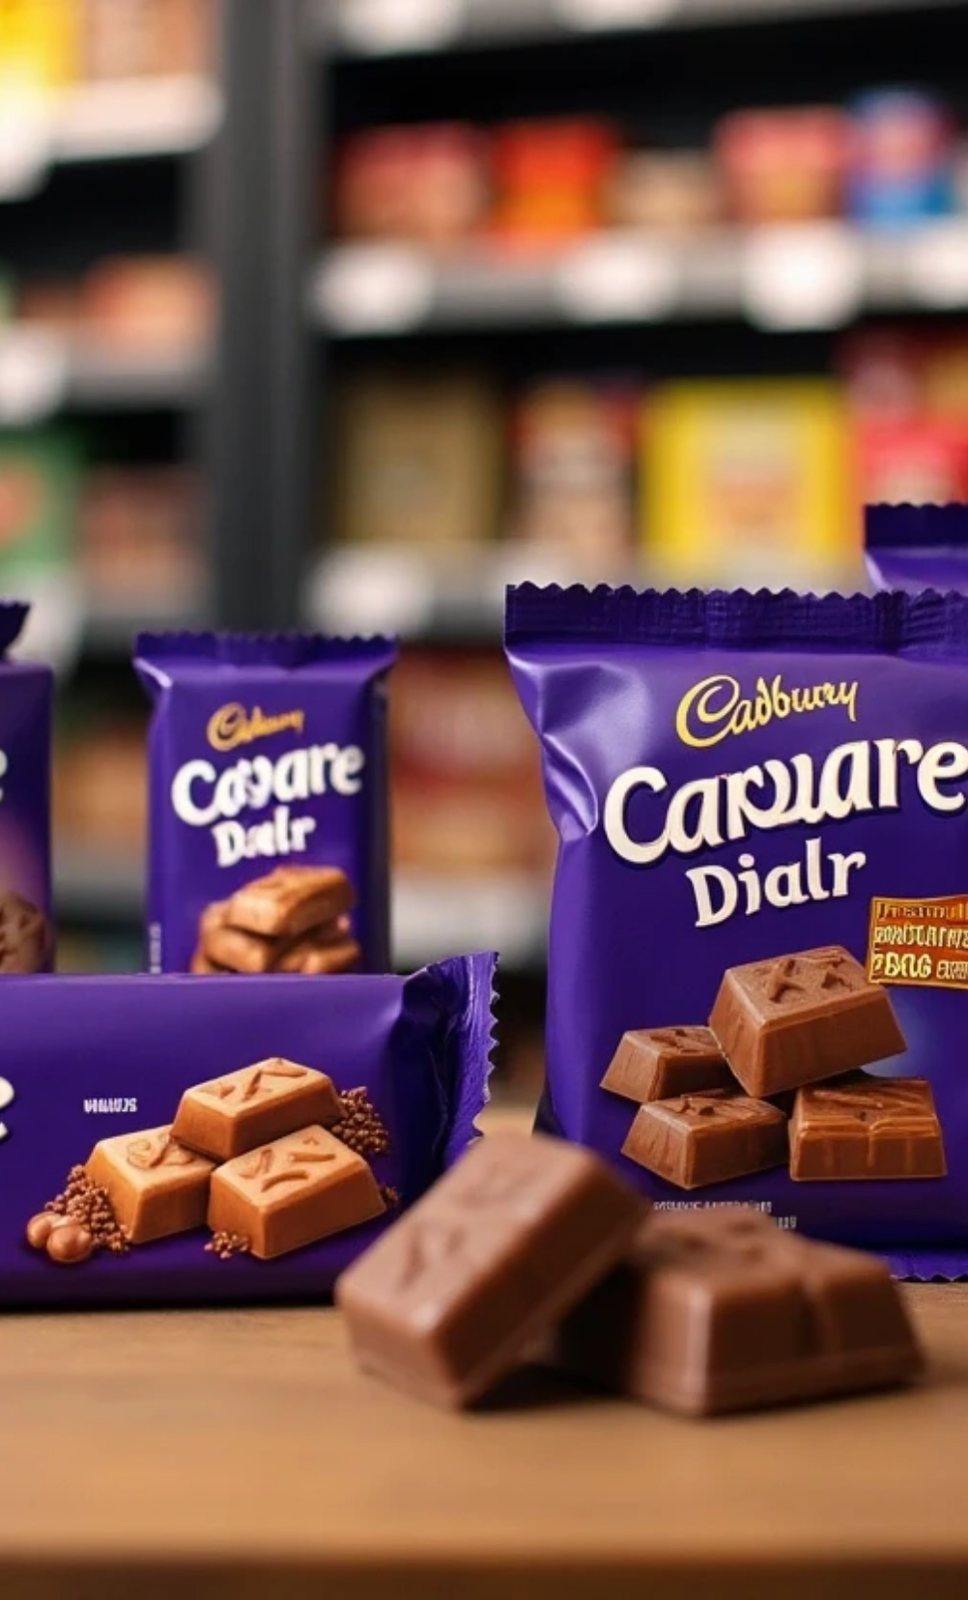
Objective
Optimize Cadbury’s chocolate portfolio pricing to protect market share and profitability amid rising input costs and shifting consumer elasticity.

Slide 5

Key Question
“Are we leaving money on the table with Dairy Milk 100g — or risking share loss to Galaxy and Corona?”

Slide 6



Mission
Maintain leadership in the 100g chocolate tablets segment.
Balance price competitiveness, margin protection, and brand equity.
Translate analytics into actionable, value-based pricing decisions.

Slide 7
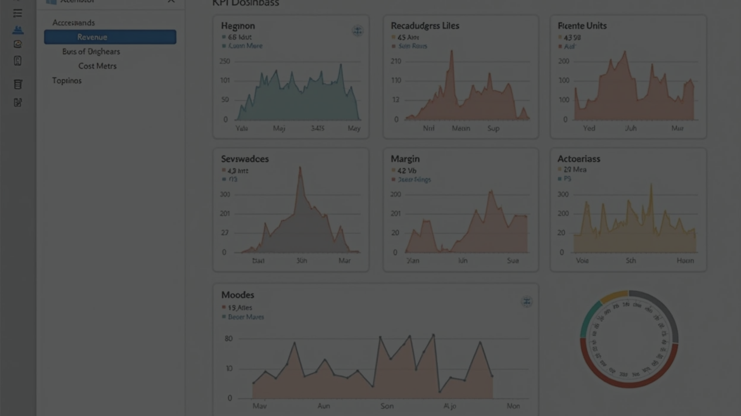
Dashboard Integration
Used Power BI to connect to integrating elasticity, revenue, and cost data. Created KPI Cards (Revenue, Margin, Units, Cost) with month-over-month variance indicators to track performance dynamically.

Slide 8
02
Market Overview (Chocolate Tablets 100g)

Slide 9
Market Overview (Chocolate Tablets 100g)
Brand | Price (EGP) | Units (avg) | Channel | Elasticity | Volume Share | Key Segment
Cadbury Dairy Milk | 35 | 120K | Modern Trade | -1.8 | 47% | Mainstream Premium
Galaxy | 37 | 83K | Modern Trade | -1.6 | 33% | Premium
Corona | 25 | 65K | Traditional | -2.5 | 20% | Value

Slide 10
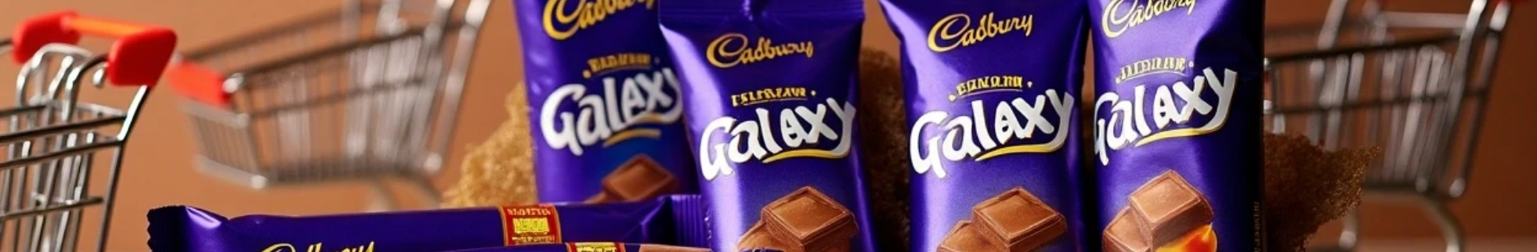

Insights
Cadbury leads volume (+40% over Galaxy) — proving strong consumer loyalty.
Galaxy sustains close price parity but lags in volume.
Corona dominates value shoppers in traditional channels due to deep discount pricing.
Elasticity Insight
Elasticity indicates Cadbury’s buyers are price sensitive, meaning excessive price increases risk large volume losses. Corona’s high elasticity (-2.5) suggests it competes purely on price, offering low strategic stability.
In our dataset, elasticity varies by brand:
Cadbury (≈ -1.8): Moderately elastic — sales respond notably to price changes.
Galaxy (≈ -1.6): Slightly less sensitive, showing stronger brand loyalty.
Corona (≈ -2.5): Highly elastic — small price increases cause big volume drops.

Slide 11
03
KPI Dashboard & Business Relationships

Slide 12
KPI Dashboard & Business Relationships
KPI | Meaning & Relationship | Business Effect | Recommended Action
Price Gap (Cadbury vs Galaxy) | Narrow (EGP -2) | Strong brand equity, stable demand | Maintain pricing, reinforce perceived value
Elasticity (-1.8) | Volume reacts quickly to price changes | Price increases reduce volume by \~9% | Defensive hold: keep price at EGP 35
Corona Segment -EGP 10 price gap | Losing budget shoppers | - | Introduce mini-packs @ EGP 30
Distribution Weighted Sales | Weak in Traditional Trade | Lost exposure in key channels | Push distribution in value outlets

Slide 13





Dashboard Features
1
2
3
Variance Indicators
Conditional Formatting
Dynamic Tooltips
+% vs last month shown beside KPIs (Revenue, Units, Margin).
SKU-level bars in red if Margin < Cost → highlights unprofitable SKUs.
show average elasticity per brand to contextualize revenue vs margin performance.

Slide 14
04
Price vs Volume Relationship

Slide 15





Insights
Cadbury’s demand curve confirms high elasticity — price increases lead to large volume losses.
Galaxy maintains steadier volume, indicating slightly stronger price tolerance.
Corona shows steep elasticity, competing purely on affordability.

Slide 16
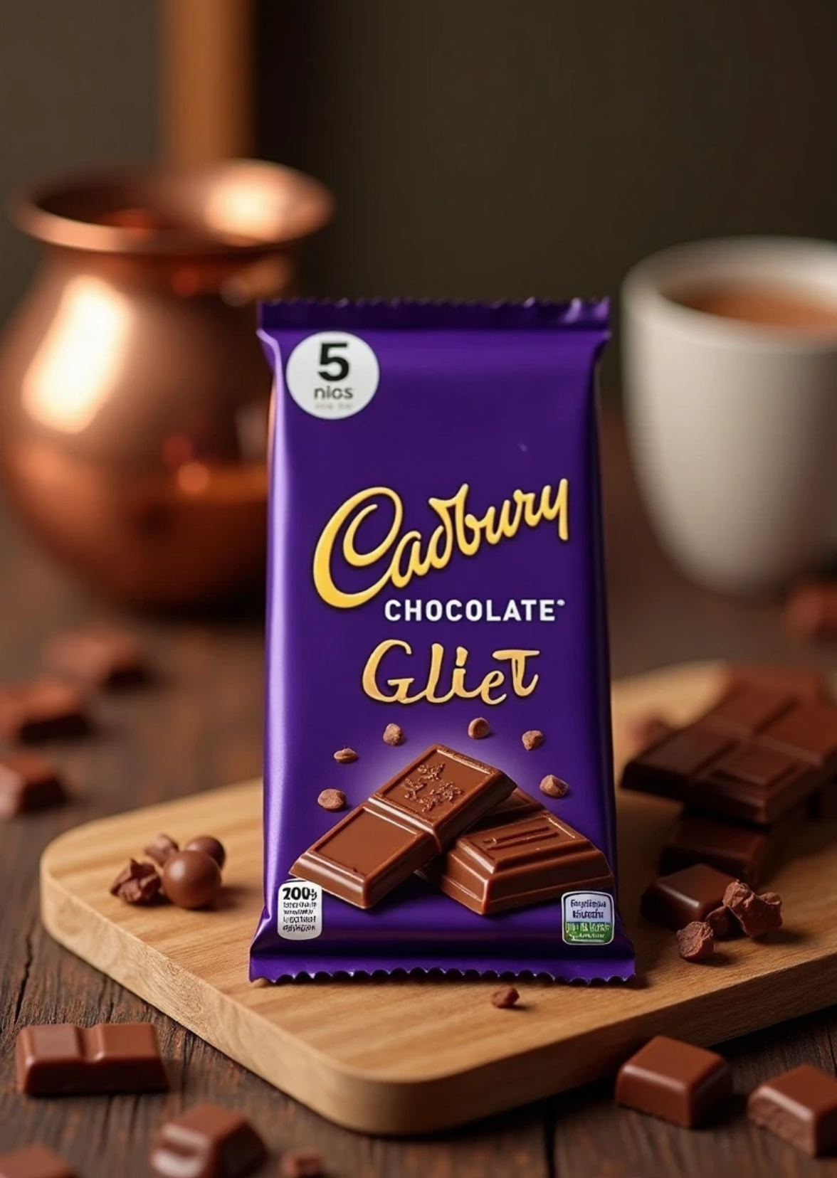
Business Implication
Cadbury’s ideal strategy is price stability — avoid reactive price hikes that may cause share erosion.

Slide 17
05
Cost & Pricing Process Relationship

Slide 18
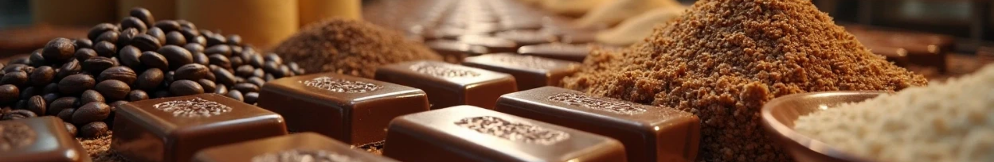
Current State
Cost-plus pricing reactive to raw material increases (Cocoa & Sugar +15%). Pricing not fully aligned with consumer willingness-to-pay (WTP) insights.

Slide 19






Actions to Improve
1
Integrate elasticity modeling into pricing strategy.
2
Shift from cost-based to value-based pricing.
3
Use Power BI early warning dashboards to track competitor price shifts and cost spikes.

Slide 20
06
Strategic Challenges

Slide 21
Strategic Challenges
Challenge | Description | Impact
Value Proposition Erosion | Minimal gap vs Galaxy | Brand differentiation risk
Budget Segment Loss | Corona undercuts by 30% | Losing price-conscious consumers
Rising Commodity Costs | +15% in inputs | Margin compression
Elasticity Pressure | High (-1.8) | Limited price flexibility

Slide 22




Dashboard Annotation Insights
1
🟣 Market Pulse
Cadbury retains revenue leadership despite cost pressures.
2
🟠 Competitive Watch
Galaxy shows price tolerance — ideal for selective price actions.
3
🟢 Efficiency Alert
Corona’s margin gap exposes vulnerability — consider premium SKU.

Slide 23
07
Strategic Recommendations

Slide 24
Strategic Recommendations
Recommendation | Rationale | Effect | Timeline
1️ Defensive Hold (EGP 35) | Avoid elasticity-triggered drop | Volume stability | Immediate
2️ “Price Lock” Campaign | Reinforce brand value | Build consumer trust | Month 1
3️ Mini-Packs (5×20g @ EGP 30) | Capture value shoppers | Regain Corona volume | Month 4
4️ Distribution Push | Expand traditional presence | +2–3% volume | Continuous

Slide 25
08
Data Experimentation Plan

Slide 26
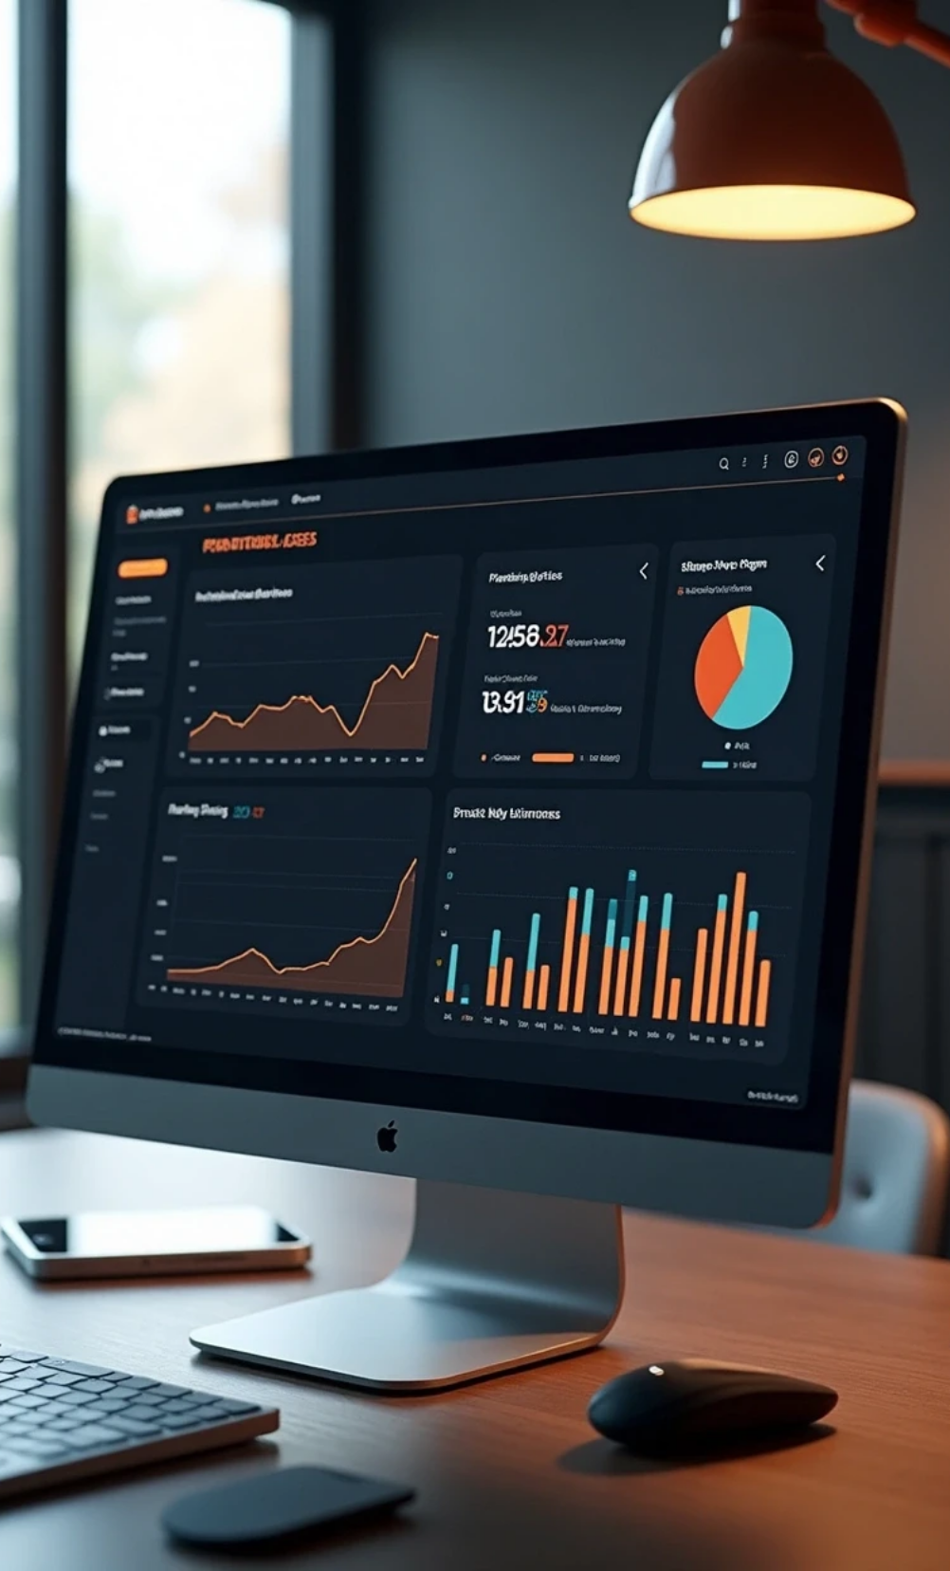
Simulations & Experiments
What-if Pricing Scenarios: Model EGP 34 / 36 for revenue–margin balance.
Mini-Pack Pilot
Cannibalization Rate = Units_DM_Mini / (Units_Corona + Units_DM_Mini)
A/B Test Campaign
Compare “Price Lock” vs “Value Offer” messaging on elasticity response.
Power BI Integration
Run simulations using parameter sliders and DAX-based elasticity recalculations for instant visualization.

Slide 27
09
Business Impact & Next Steps

Slide 28
Business Impact & Next Steps
Area | Expected Impact | KPI Target
Volume Retention | +2% vs current | Maintain 120K monthly units
Market Share | Stable 47% | Maintain leadership
New SKU (Mini-Pack) | +10K incremental units | <15% cannibalization
Margin | +1–2% improvement | ≥45% gross margin

Slide 29

Next Steps
1️ Finalize elasticity-based pricing simulation model (Week 1)
2️ Present pilot to Marketing & Sales Director (Week 2)
3️ Launch Mini-Pack SKU (Month 4)
4️ Evaluate elasticity response post-launch (Month 6)

Slide 30
10
Summary Message to Leadership

Slide 31
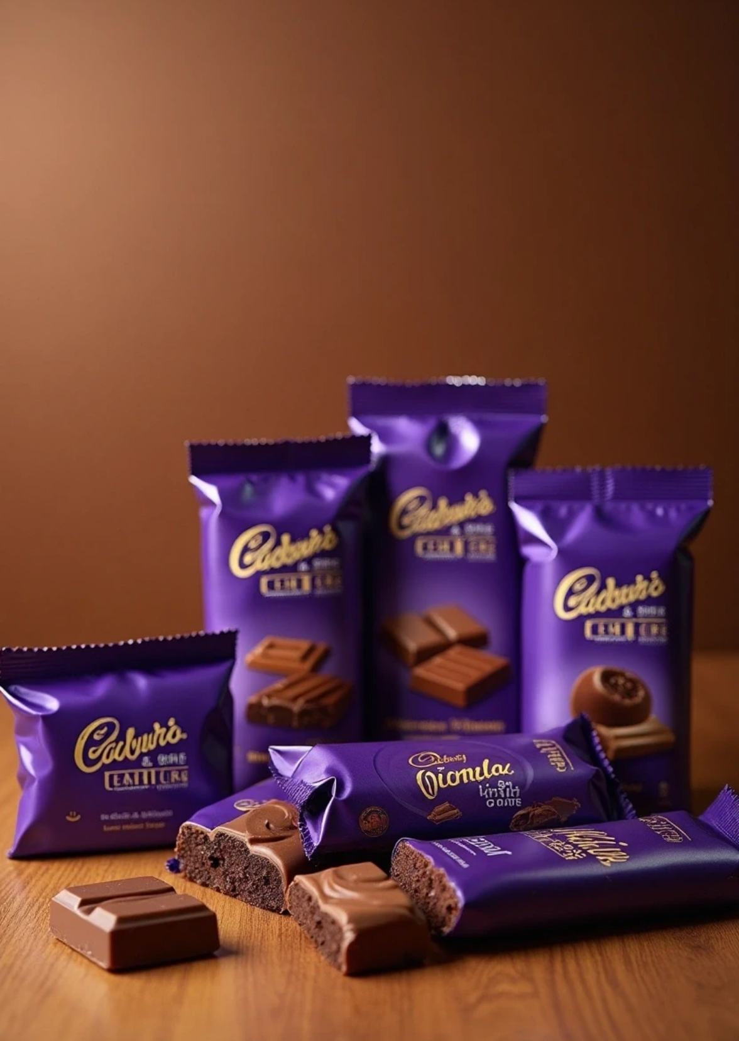
Summary Message to Leadership
“Cadbury’s strength lies in its brand trust and volume leadership. Our pricing must protect this leadership — not chase short-term wins.”

Slide 32



Strategic Vision
1
2
Defend premium brand equity.
Re-enter value segment through innovation (mini-packs).
3
4
Institutionalize elasticity-based, data-driven pricing.
Build sustainable pricing agility through Power BI automation.

Slide 33

Thank You

